Slide 1

IE 7615 Deep Learning for AI Generative Case Study Project
Group 7
Parth Saraykar
Novia D’silva
Sanika Chaudhari
Sailee Chaudhari
‹#›
Notes:
‹#›

Slide 2
Objective
Project Goals:
Understand architectural principles behind Transformers and Diffusion Models
Implement and fine-tune conditional diffusion model using text embeddings
Explore text-image alignment and multimodal representations
Evaluate generated results quantitatively (FID, IS) and qualitatively
Reflect on ethical and societal implications of generative AI
Our Approach: Systematic evaluation of Stable Diffusion v1.5 with CLIP text encoder across:
7 CFG scales
4 noise schedulers
1 text encoder
936 experiments | 460+ images generated
‹#›
Notes:
‹#›

Slide 3
Methodology - Dataset Preparation
Dataset: COCO 2017 Validation Set
Size: 5,000 image-caption pairs
Resolution: 512 × 512 pixels
Preprocessing:
Resized and normalized images
Tokenized captions (max 77 tokens)
Applied data augmentation
Text Embedding Model:
Primary: CLIP ViT-B/32 (512-dim embeddings)
Comparison: CLIP ViT-L/14 (768-dim embeddings)
Preprocessing: Tokenization → Embedding extraction
‹#›
Notes:
‹#›

Slide 4
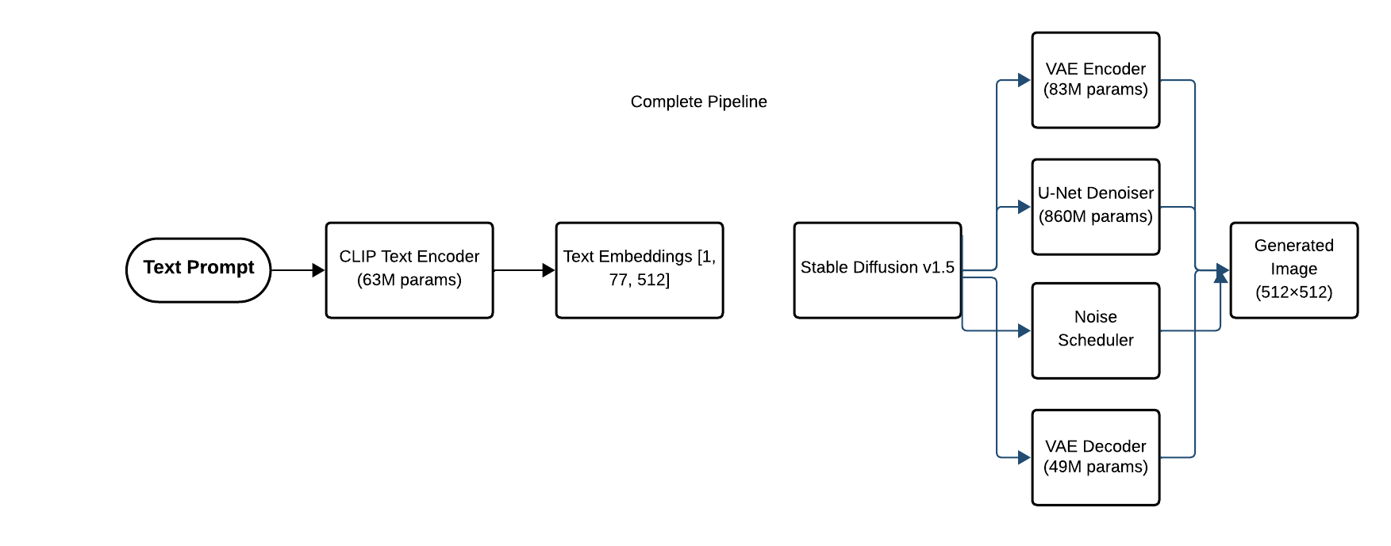
Model Architecture
Total Parameters: ~1.055 billion
Key Components:
Text conditioning via CLIP embeddings
Latent space diffusion (64×64 latents)
Classifier-free guidance
Multiple noise scheduling algorithms
‹#›
Notes:
‹#›

Slide 5
Experimental Design
Test Prompts (8 diverse categories):
"A golden retriever puppy playing in a sunny garden"
"A futuristic city skyline at night with neon lights"
"An astronaut floating in space near Earth"
"A peaceful mountain lake with reflection at sunset"
+ 4 more diverse prompt
Robustness: 5 different seeds per configuration
Experiment | Variables Tested | Images Generated
CFG Scale | 1.0, 3.0, 5.0, 7.5, 10.0, 15.0, 20.0 | 280
Schedulers | DDIM, PNDM, Euler, DPM++ | 160
Text Encoders | CLIP ViT-B/32 vs ViT-L/14 | 20
‹#›
Notes:
‹#›

Slide 6

Results - Generated Examples: Milestone 1
‹#›
Notes:
‹#›

Slide 7

Milestone 2 results
‹#›
Notes:
‹#›

Slide 8
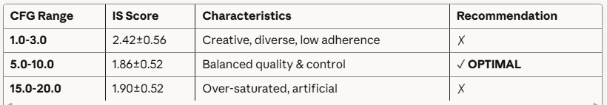
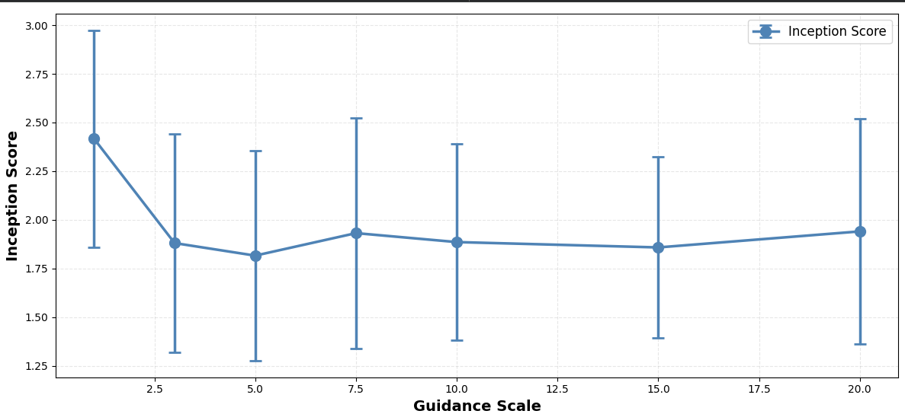
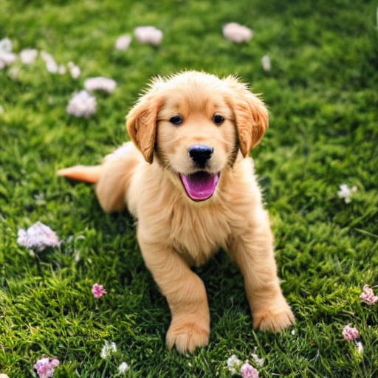
Evaluation - CFG Scale Impact
Classifier-Free Guidance Analysis:
Key Finding: CFG=7.5-8.5 provides best trade-off between creativity and prompt adherence
‹#›
Notes:
‹#›

Slide 9
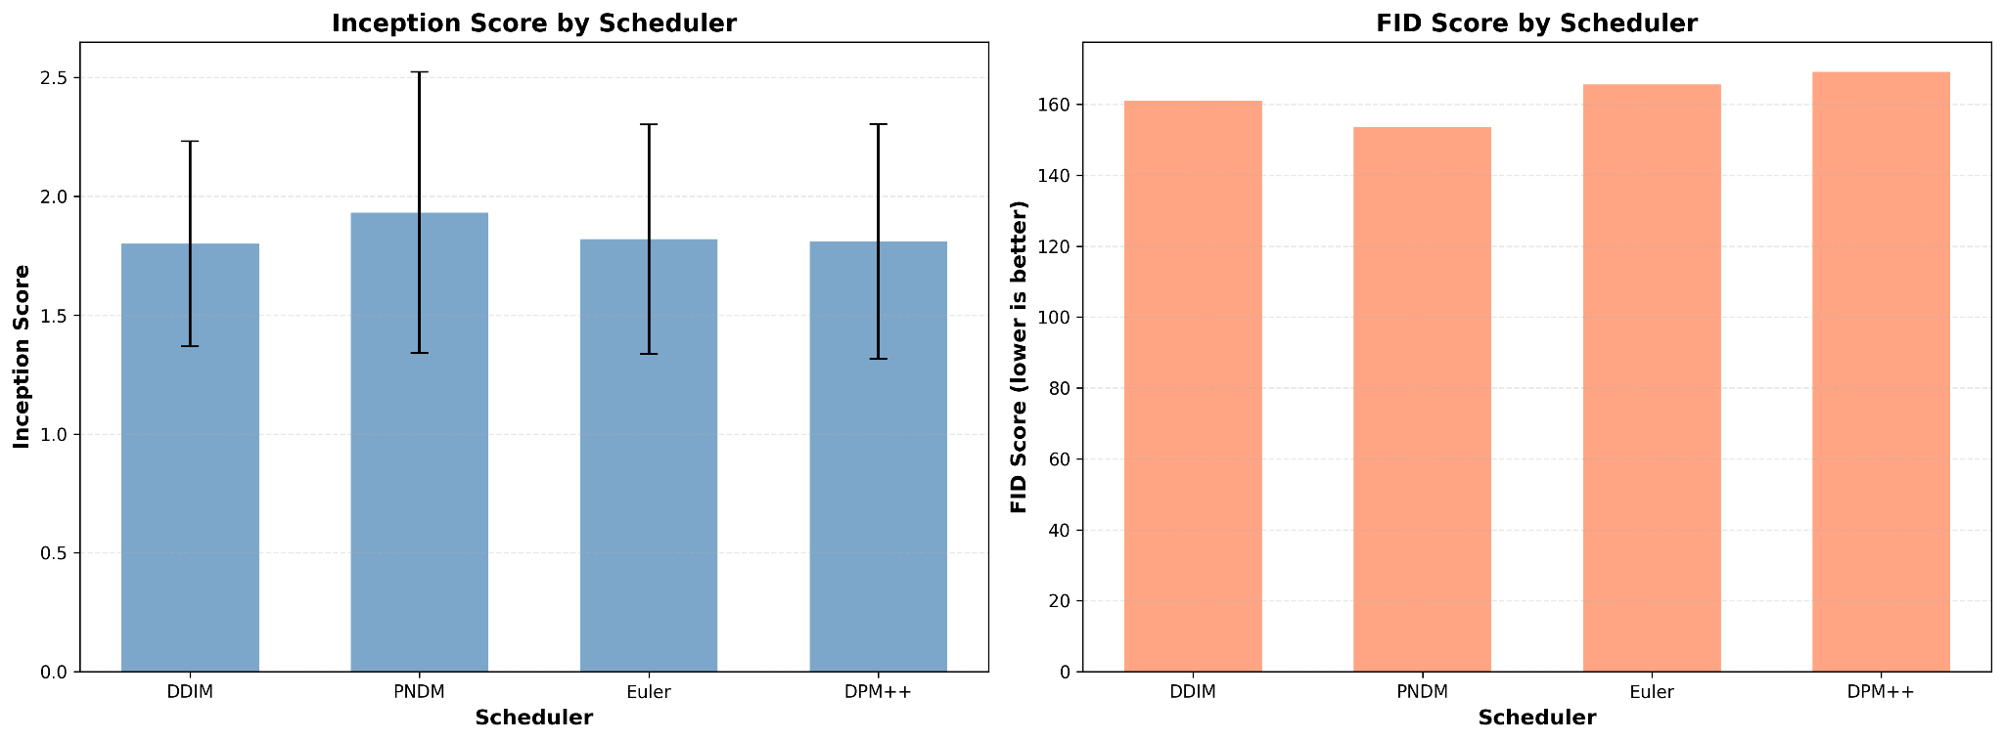
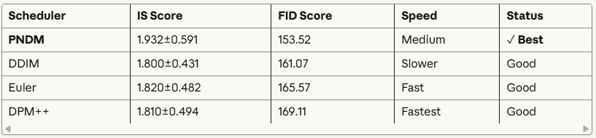
Evaluation - Schedule Comparison
Noise Scheduler Performance:
‹#›
Notes:
‹#›

Slide 10
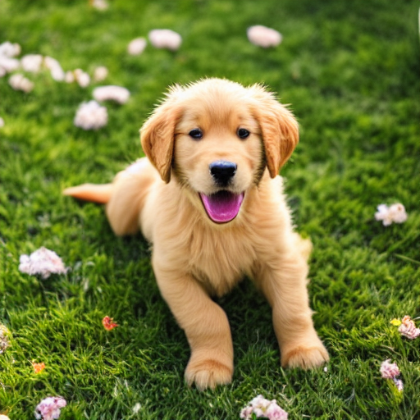
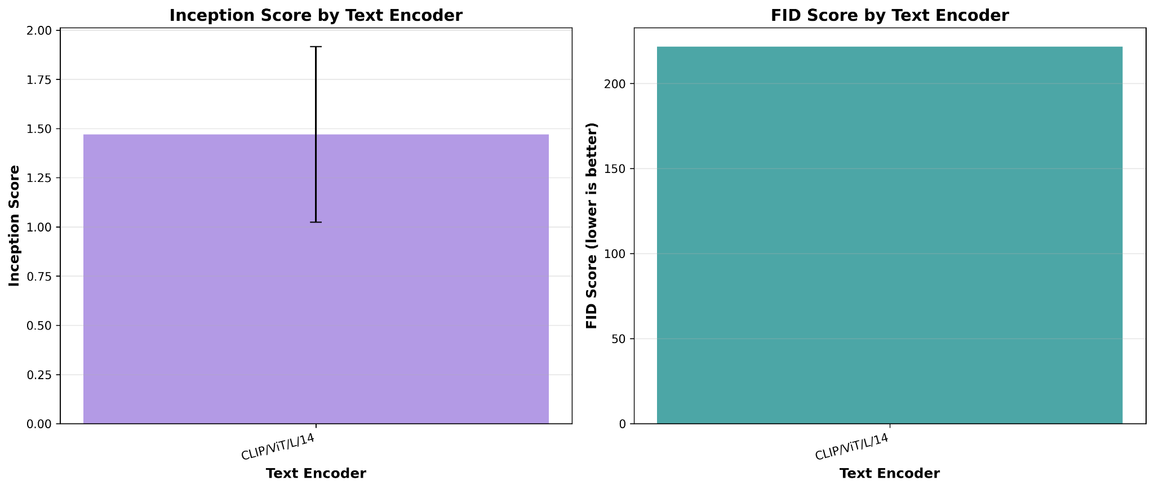
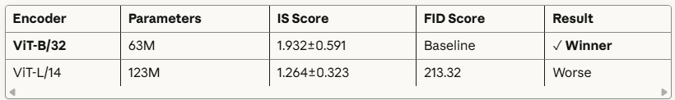
Evaluation- Encoder Comparison
Text Encoder Comparison:
‹#›
Notes:
‹#›

Slide 11
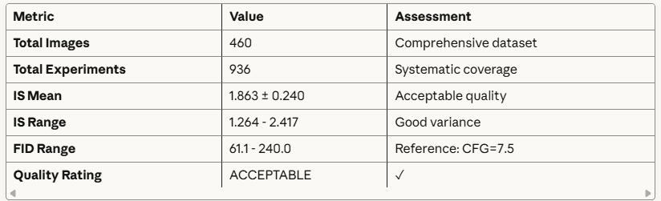
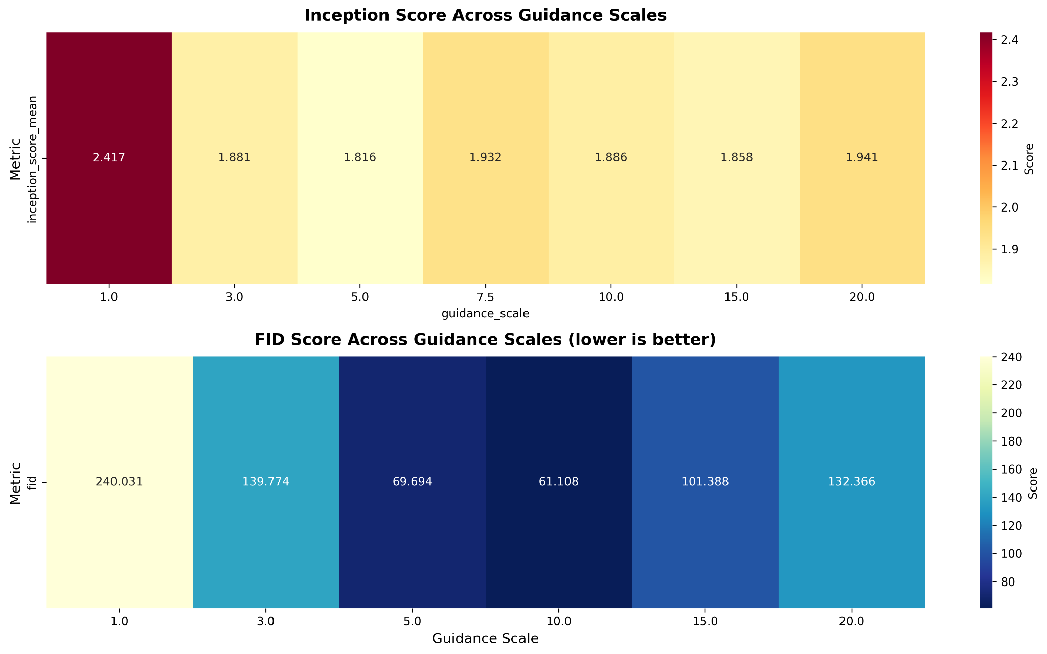
Quantitative Metrics Summary
Evaluation Methodology:
Inception Score: Quality + diversity (higher is better)
FID: Realism vs reference (lower is better)
Calculated using pretrained Inception v3
‹#›
Notes:
‹#›

Slide 12
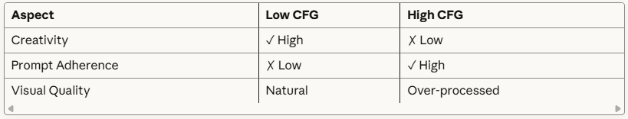
Analysis & Discussion
Key Findings:
1. Parameter Impact Hierarchy:
CFG Scale: HIGH impact (most critical parameter)
Text Encoder: MEDIUM impact (compatibility > size)
Scheduler: LOW impact (minimal differences)
2. Optimal Configuration:
CFG Scale: 7.5-8.5
Scheduler: PNDM
Text Encoder: CLIP ViT-B/32
Inference Steps: 50
3. Trade-offs:
‹#›
Notes:
‹#›

Slide 13
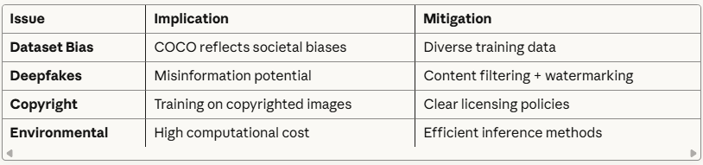
Ethical Considerations & Limitations
Ethical Concerns:
Current Limitations:
Resolution: 512×512 (lower than SDXL)
Sample size: 460 images for evaluation
No domain-specific fine-tuning
FID reference: used generated images
Future Work: → Upgrade to Stable Diffusion XL (1024×1024) → Implement LoRA fine-tuning → Expand evaluation with real images as FID reference → Test complex multi-object compositions
‹#›
Notes:
‹#›

Slide 14
Conclusion & Takeaways
Data Preparation (20%): 5,000 COCO images preprocessed with CLIP embeddings
Model Implementation (40%): 936 experiments across 3 parameter types
Evaluation (10%): FID + IS metrics with comprehensive analysis
Analysis (10%): Identified optimal parameters and trade-offs
Key Learnings:
CFG Scale is the most critical hyperparameter for quality
Smaller encoders can outperform larger ones with proper compatibility
Scheduler choice has minimal impact on final quality
Multiple seeds essential for reliable evaluation
Trade-off between creativity and control is fundamental
‹#›
Notes:
‹#›

